Slide 1

Central Processing Unit
Unit - iv

Slide 2
Content
General register organization
Stack organization
Instruction format
Addressing modes
Data transfer and manipulation instructions
Program control
RISC, and CISC

Slide 3
1. General register organization

Slide 4
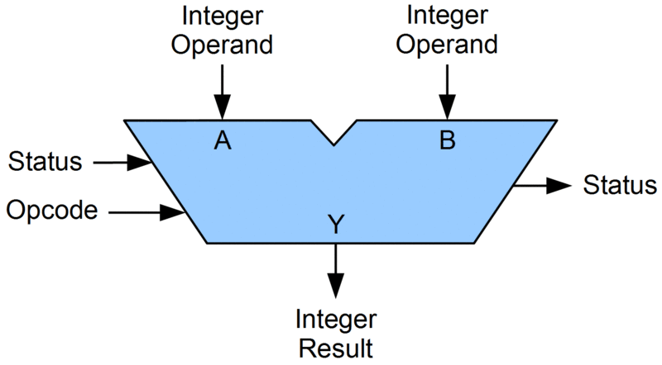
Introduction
The central processing unit is where all the calculations and logic operations take place.
CPU performs data-processing operations.
Main parts of the CPU are:
  Arithmetic Logic Unit (ALU)
  Control Unit (CU)
  Registers
Register Set
Control Unit
ALU

Slide 5
Introduction
The registers set stores intermediate data used during the execution of the instructions.
The ALU performs the required micro-operations for executing the instructions.
The Control unit supervises the transfer of information among the registers and instructs the ALU as to which operation to perform.
Register Set
Control Unit
ALU

Slide 6
General Register Organization
Registers are more convenient and efficient to store pointers, return addresses, counters, temporary results, etc.
In Basic Computer, there is only one general-purpose register, the Accumulator (A), but in modern CPUs, there are many general-purpose registers.
It is advantageous to have many registers:
  Transfer between registers within the processor is relatively fast.
  Going “off the processor” to access memory is much slower.

Slide 7
General Register Organization
When a large number of registers are included in the CPU it is efficient to connect them through a common system bus.
Because registers communicate with each other not only for direct data transfers but also while performing various microoperations.

Slide 8
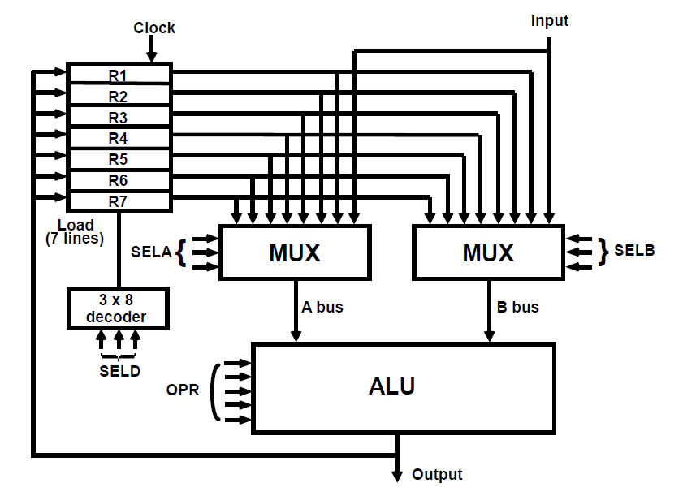
A Bus organization for seven CPU registers
The control unit directs the information flow through ALU by
  Selecting various components in the system.
  Selecting the Function of ALU.
Example: R1 ← R2 + R3
  MUX A selector (SELA): BUS A ← R2.
  MUX B selector (SELB): BUS B ← R3.
  ALU operation selector (OPR): ALU to ADD.
  Decoder destination selector (SELD): R1←Out Bus
The entire information is passed through the Control Word.

Slide 9

Control Word Format
The control word is determined by the sum of the binary selection inputs.
It is divided into four sections.
  SELA, SELB, and SELD each have three bits,
  the OPR field has four bits.
  For a total of 13 bits in the control word.
Three bits of SELA choose a source register for the ALU’s A input.
Three bits of SELB choose a source register for the ALU’s B input.
The three bits of SELD pick a target register.
The four bits of OPR determine the ALU operation

Slide 10
Control Word Format
ALU operations encoding
OPR Select | Operation | Symbol
00000 | Transfer A | TSFA
00001 | Increment A | INCA
00010 | Add A + B | ADD
00101 | Subtract A - B | SUB
00110 | Decrement A | DECA
01000 | ADD A and B | AND
01010 | OR A and B | OR
01100 | XOR A and B | XOR
01110 | Complement A | COMA
10000 | Shift right A | SHRA
11000 | Shift left A | SHLA
Register Selection Field Encoding
Binary Code | SELA | SELB | SELD
000 | Input | Input | None
001 | R1 | R1 | R1
010 | R2 | R2 | R2
011 | R3 | R3 | R3
100 | R4 | R4 | R4
101 | R5 | R5 | R5
110 | R6 | R6 | R6

Slide 11
Micro-Operations at ALU
Micro-operation | SELA | SELB | SELD | OPR | Control Word
R1 ← R2 – R3 | R2 | R3 | R1 | SUB | 010 011 001 00101
R4 ← R4 ∨ R5 | R4 | R5 | R4 | OR | 100 101 100 01010
R6 ← R6 + R1 | - | R6 | R1 | INCA | 110 000 110 00001
R7 ← R1 | R1 | - | R7 | TSFA | 001 000 111 00000
Output ← R2 | R2 | - | None | TSFA | 010 000 000 00000
Output ← Input | Input | - | None | TSFA | 000 000 000 00000
R4 ← shl R4 | R4 | - | R4 | SHLA | 100 000 100 11000
R5 ← 0 | R5 | R5 | R5 | XOR | 101 101 101 01100
Control Word Format

Slide 12
2. Stack organization

Slide 13
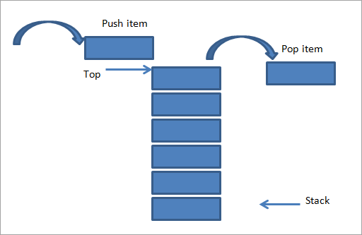
Stack organization
A stack is an ordered linear list in which all insertions and deletions are made at one end, called the top.
It uses the Last In First Out (LIFO) access method which is the most popular access method in most of the CPUs.
A register is used to store the address of the topmost element of the stack which is known as Stack Pointer(SP) because its value always points at the top of the stack.
The main two operations that are performed on the operands of the stack are:
  Push Operation: The operation of inserting an item onto a stack is called push operation.
  Pop Operation: The operation of deleting an item onto a stack is called pop operation.

Slide 14
Stack in Computer architecture
There are two types of stack organization that are used in computer architecture:
  Register stack: It is built using a register.
  Memory stack: It is the logical part of memory allocated as the stack. The logically partitioned part of RAM is used to implement the stack.

Slide 15
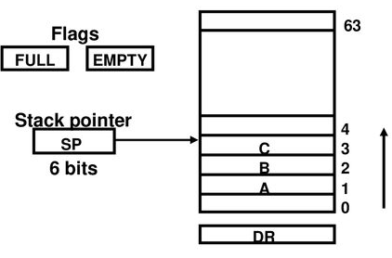
Register Stack Organization
A stack can be organized as a collection of a finite number of memory words or registers.
In the figure, there are 64 registers used to make a register stack. The numbers 0,1,2,3,….. 63 denote the address of different registers (Binary address representation is 000000 … 111111).
SP is a pointer that points to the top of the stack i.e. it currently points to the item at the top (in this figure SP contains a 6-bit address).
In a 64-word stack, the stack pointer contains 6 bits because 2⁶=64.
Since SP has only 6 bits, it cannot exceed a number greater than 63(111111 in binary). When 63 is incremented by 1 the result is 0 since 111111+1=1000000, but SP can accommodate only the six least significant bits → SP points to the 000000 address register which implies the stack is full.

Slide 16
Register Stack Organization
The two more registers called FULL and EMPTY are used. These are made up of flip-flops also known as flags. It indicates whether the stack is full or not.
  If FULL = 1, then EMPTY = 0 → stack is full.
  If FULL= 0, then EMPTY =1 → stack is empty.
DR is the data register through which data is transferred to and from the stack.
Zero address instructions are used in registers stack organization i.e. the address that does not contain the address of the operands.
1st item is stored at address 1 and last item is stored at address 0.

Slide 17
Register Stack Organization
For PUSH Operation initially:
SP← 0
FULL← 0
EMTY← 1
PUSH Operation
POP Operation
SP ← SP+1 Increment stack pointer
M[SP] ← DR Write on top of the stack
If (SP = 0) then (FULL ← 1) Check if the stack is full
EMTY← 0 Stack is not empty
DR ← M[SP] Read from the top of the stack
SP← SP-1 Decrement the stack pointer
If (SP=0) then (EMTY←1) Check if the stack is empty
FULL ← 0 Stack is not full

Slide 18
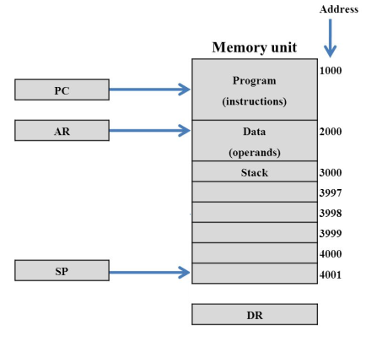
Memory Stack Organization
A stack may be implemented in a computer's random access memory (RAM).
A stack is implemented in the CPU by allocating a portion of memory to a stack operation and utilizing a processor register as a stack pointer. The stack pointer is a CPU register that specifies the stack's initial memory address.
The RAM is divided into three logical parts:
  Program: The logical part of RAM where programs are stored.
  Data: It is the logical part of the RAM where data(operands) are stored.
  Stack: It is the part of RAM used to implement stack.

Slide 19
memory Stack Organization
PUSH Operation
POP Operation
SP ← SP -1 Decrement stack pointer
M[SP] ← DR Write on top of the stack
DR ← M[SP] Read from the top of the stack
SP← SP + 1 Increment the stack pointer
The upper limit register and lower limit register are used to check the stack’s overflow (Full) and underflow (Empty).
Most computers do not provide hardware to check stack overflow (full stack) or underflow (empty stack). It must be done in the software

Slide 20
Reverse Polish Notation
Introduction
The stack organization is very effective in evaluating the arithmetic expression.
Computers found difficulties in evaluating common arithmetic mathematical expressions because they are represented in “Infix notation” (Eg. A+B*C+D).
The Polish mathematician Lukasiewicz demonstrated that arithmetic expressions can be represented in prefix notation.
Types of Notations
Infix notation (Eg. A+B)
Prefix notation or Polish notation (Eg. +AB)
Postfix notations or Reverse Polish Notation (Eg. AB+)
Used by general register organization
Used by stack organization

Slide 21
Reverse Polish Notation
Reverse Polish notation (RPN) is a method for conveying mathematical expressions without the use of separators such as brackets and parentheses.
In this notation, the operators follow their operands, hence removing the need for the brackets to define evaluation priority.
The operation is read from left to right but execution is done every time an operator is reached.
This notation is suited for computers and calculators since there are fewer characters to track and fewer operations to execute.
Reverse Polish notation is also known as postfix notation
Example:
(A+B)*(C*(D+E)+F)
RPN is AB+ DE+C*F+*

Slide 22
Evaluation of Arithmetic Expression
Let us consider an arithmetic expression: (3*4) + (5*6).
In Reverse Polish Notation: 34*56*+
Rules
In RPN, the numbers and operators are listed one after another, and an operator always acts on the most recent number in the list.
The numbers can be thought of as forming a stack, and the most recent number goes on the top of the stack.
An operator takes the appropriate number of arguments from the top of the stack and replaces them with the result of the operation.

Slide 23
Evaluation of Arithmetic Expression
Let us consider an arithmetic expression: (3*4) + (5*6).
In Reverse Polish Notation: 34*56*+
Stack representation
3
4
*
5
6
*
+
3
4
3
12
5
12
6
5
12
30
12
42

Slide 24
Processor Organization
In general, most processors are organized in one of three ways:
  Single register (Accumulator) organization
    Basic Computer is a good example
    Accumulator is the only general-purpose register
  General register organization
    Used by most modern computer processors
    Any of the registers can be used as the source or destination for computer operations
  Stack organization
    All operations are done using the hardware stack
    For example, an OR instruction will pop the two top elements from the stack, do a logical OR on them, and push the result on the stack

Slide 25
3. Instruction format

Slide 26
Instruction Format
In computer architecture, the instruction format is defined as a standard machine instruction format that can be directly decoded and executed by the central processing unit ( CPU ).
The instruction format is simply a sequence of bits ( binary 0 or 1 ) contained in a machine instruction that defines the layout of the instruction.
The machine instruction contains the number of bits (patterns of 0 and 1 ). These bits are grouped together and called fields.
Each field of the machine instruction provides specific information to the CPU regarding the operation to be performed and the location of the data.
A instruction is of various lengths depending upon the number of addresses it contains. Generally, CPU organizations are of three types on the basis of the number of address fields:
  Single Accumulator organization
  General register organization
  Stack organization

Slide 27
CPU Organization
Single Accumulator Organization
  All the operations on a system are performed with an implied accumulator register. The instruction format in this type of computer uses one address field.
  For example, the instruction for arithmetic addition is defined by an assembly language instruction ‘ADD.’ Where X is the operand’s address, the ADD instruction results in the operation.
        AC ← AC + M[X].
  AC is the accumulator register, and M[X] symbolizes the memory word located at address X.
General Register Organization
  The general register type computers employ two or three address fields in their instruction format. Each address field specifies a processor register or a memory.
  An instruction symbolized by ADD R1, X specifies the operation R1 ← R1 + M [X].
  This instruction has two address fields: register R1 and memory address X.
Stack Organization
  A computer with a stack organization has PUSH and POP instructions that require an address field. Hence, the instruction PUSH X pushes the word at address X to the top of the stack. The stack pointer updates automatically.
  In stack-organized computers, the operation type instructions don’t require an address field as the operation is performed on the two items on the top of the stack.

Slide 28
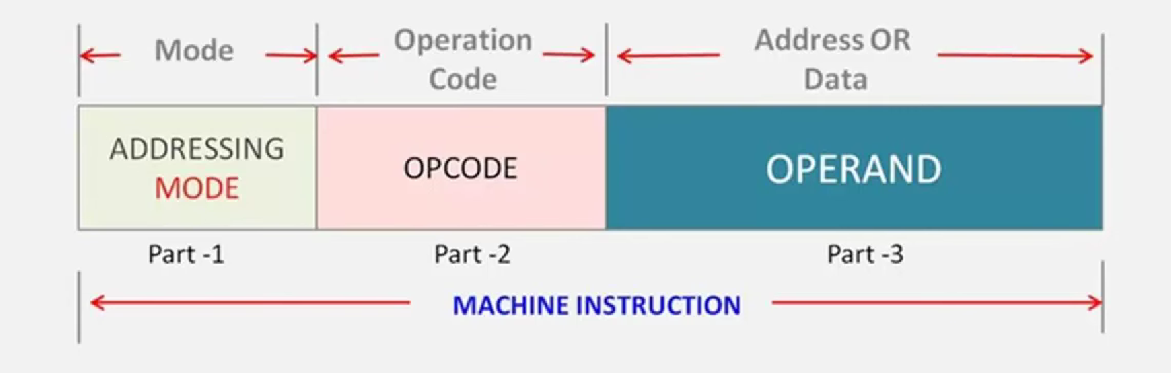
Instruction Format Representation
Instruction format is a sequence of bits contained int the machine instruction that defines the layout of an instruction.

Slide 29
Instruction Format Type
The set of instructions that manages the operation codes is called the format of instruction. The design of bits in instruction is supported by the format of instruction.
The length of instruction is generally preserved in multiples of character, which is 8 bits. Depending upon the number of addresses, the format of instruction is of variable length.
Types of instruction format include:
  Zero(0) Address Instruction format
  One(1) Address Instruction format
  Two(2) Address Instruction format
  Three(3) Address Instruction format

Slide 30
  ZERO (0) ADDRESS INSTRUCTION FORMAT
This instruction does not have an operand field, and the location of operands is implicitly represented.
The stack-organized computer system supports these instructions.
To evaluate the arithmetic expression, it is required to convert it into reverse Polish notation.
MODE | OPCODE
TOS: Top of the Stack
  PUSH A TOS ← A
  PUSH B TOS ← B
  ADD TOS ← (A + B)
  PUSH C TOS ← C
  PUSH D TOS ← D
  ADD TOS ← (C + D)
  MUL TOS ← (C + D) ∗ (A + B)
  POP X M [X] ← TOS
Example: Consider the below operations, which show how X = (A + B) ∗ (C + D) expression will be written for a stack-organized computer.

Slide 31
  ONE (1) ADDRESS INSTRUCTION FORMAT
The instruction format in which the instruction uses only one address field is called the one address instruction format
In this type of instruction format, one operand is in the accumulator and the other is in the memory location
It has only one operand
It has two special instructions LOAD and STORE
MODE | OPCODE | OPERAND
Example: The program to evaluate X = (A + B) ∗ (C + D) is as follows:
LOAD: This is used to transfer the data to the accumulator.
STORE: This is used to move the data from the accumulator to the memory.
  M[ ] is any memory location.
  M[T] addresses a temporary memory location for storing the intermediate result.
LOAD | A | AC ← M [A]
ADD | B | AC ← A [C] + M [B]
STORE | T | M [T] ← AC
LOAD | C | AC ← M [C]
ADD | D | AC ← AC + M [D]
MUL | T | AC ← AC ∗ M [T]
STORE | X | M [X] ← AC

Slide 32
  TWO (2) ADDRESS INSTRUCTION FORMAT
The instruction format in which the instruction uses only two address fields is called the two-address instruction format
This type of instruction format is the most commonly used instruction format
As in one address instruction format, the result is stored in the accumulator only, but in two addresses instruction format the result can be stored in different locations
This type of instruction format has two operands
It requires shorter assembly language instructions
MODE | OPCODE | OPERAND 1 | OPERAND 2
Example: The program to evaluate X = (A + B) ∗ (C + D) is as follows:
  The MOV instruction transfers the operands to the memory from the processor registers. R1, R2 registers.
MOV | R1, A | R1 ← M [A]
ADD | R1, B | R1 ← R1 + M [B]
MOV | R2, C | R2 ← M [C]
ADD | R2, D | R2 ← R2 + M [D]
MUL | R1, R2 | R1 ← R1 ∗ R2
MOV | X, R1 | M [X] ← R1

Slide 33
  THREE (3) ADDRESS INSTRUCTION FORMAT
The instruction format in which the instruction uses the three address fields is called the three-address instruction format.
The format of a three-address instruction requires three operand fields. These three fields can be either memory addresses or registers
It requires shorter assembly language instructions
MODE | OPCODE | OPERAND 1 | OPERAND 2 | OPERAND 3
Example: The program to evaluate X = (A + B) ∗ (C + D) is as follows:
  Two processor registers, R1 and R2.
  The symbol M [A] denotes the operand at memory address symbolized by A. The operand1 and operand2 contain the data or address that the CPU will operate. Operand 3 contains the result’s address.
ADD | R1, A, B | R1 ← M[A] + M [B]
ADD | R2, C, D | R2 ← M[C] + M [D]
MUL | X, R1, R2 | M [X] ← R1 ∗ R2

Slide 34
4. Addressing Modes

Slide 35
Addressing modes
The operation field of an instruction specifies the operation to be performed. This operation will be executed on some data which is stored in computer registers or the main memory.
Addressing modes define the rules and mechanisms by which the processor calculates the effective memory address or operand location for data operations.
The way any operand is selected during the program execution is dependent on the addressing mode of the instruction. The purpose of using addressing modes is as follows:
  To give the programming versatility to the user.
  To reduce the number of bits in addressing the field of instruction.

Slide 36
1 Implied/Implicit Addressing Modes
2 Immediate Addressing Modes
3 Register Direct Addressing Modes
4 Register Indirect Addressing Modes
5 Auto-Increment Addressing Modes
6 Auto-Decrement Addressing Modes
Types of Addressing Modes
7 Direct Addressing Modes
8 Indirect Addressing Modes
9 Displacement Addressing Modes
10 Relative Addressing Modes
11 Indexed Addressing Modes
12 Base Register Addressing Modes
13 Stack Addressing Modes

Slide 37
1. Implied/Implicit Addressing Modes:
Address of the operands is specified implicitly in the definition of the instruction.
All registers, reference the instructions that use an accumulator, and Zero-address instructions in a stack-organized computer are implied addressing mode instructions.
EA = AC, or EA = Stack[SP]
Example: CMA, CLA, PUSH, POP, etc.
1 Implied/Implicit Addressing Modes
2 Immediate Addressing Modes
3 Register Direct Addressing Modes
4 Register Indirect Addressing Modes
5 Auto-Increment Addressing Modes
Instruction
OPCODE
6 Auto-Decrement Addressing Modes
7 Direct Addressing Modes
2. Immediate Addressing Modes
The operand is defined in the instruction itself which is used to perform a specified operation.
Instruction has an operand field instead of an address field.
Help initialize registers to a constant value.
Example: ADD 8 will increment the value stored in the accumulator by 8.
8 Indirect Addressing Modes
9 Displacement Addressing Modes
10 Relative Addressing Modes
11 Indexed Addressing Modes
12 Base Register Addressing Modes
Instruction
OPCODE | OPERAND
13 Stack Addressing Modes

Slide 38
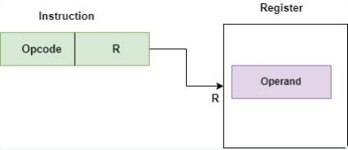
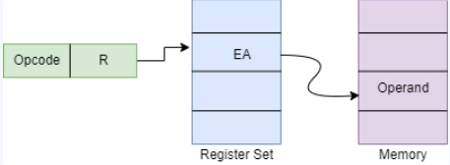
3. Register Direct Addressing Modes:
Address specified in the instruction is the register address.
Designated operand need to be in a register.
Shorter address than the memory address. Faster to acquire an operand than the memory addressing.
Saving address field in the instruction.
EA = IR(R) (IR(R): Register field of IR)
Example: MOV R1, 35H
1 Implied/Implicit Addressing Modes
2 Immediate Addressing Modes
3 Register Direct Addressing Modes
4 Register Indirect Addressing Modes
5 Auto-Increment Addressing Modes
6 Auto-Decrement Addressing Modes
7 Direct Addressing Modes
4. Register Indirect Addressing Modes
The instruction defines a register in the CPU that stores the effective address of the operand in memory.
Only one reference to the memory is required to fetch the operand. The specified register contains the address of the operand instead of the operand.
Example: MOV R1, [R2]
8 Indirect Addressing Modes
9 Displacement Addressing Modes
10 Relative Addressing Modes
11 Indexed Addressing Modes
12 Base Register Addressing Modes
13 Stack Addressing Modes

Slide 39
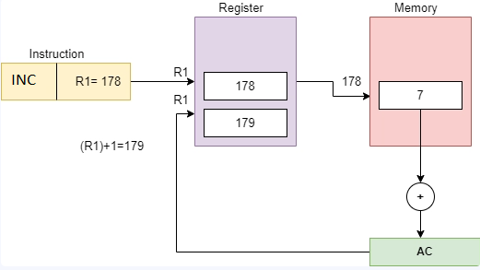
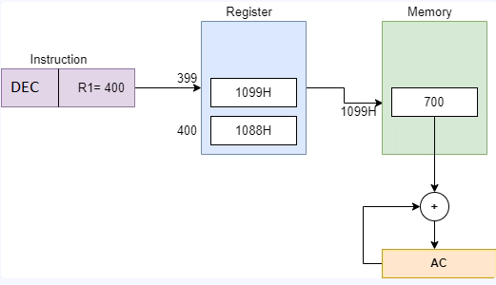
5. Auto-Increment Addressing Modes:
When the address in the register is used to access memory, the value in the register is incremented by 1 automatically.
EA = content of the register
Example: INC R1
1 Implied/Implicit Addressing Modes
2 Immediate Addressing Modes
3 Register Direct Addressing Modes
4 Register Indirect Addressing Modes
5 Auto-Increment Addressing Modes
6 Auto-Decrement Addressing Modes
7 Direct Addressing Modes
6. Auto-Decrement Addressing Modes
When the address in the register is used to access memory, the value in the register is decremented by 1 automatically.
EA = content of the register
Example: DEC R1
8 Indirect Addressing Modes
9 Displacement Addressing Modes
10 Relative Addressing Modes
11 Indexed Addressing Modes
12 Base Register Addressing Modes
13 Stack Addressing Modes

Slide 40
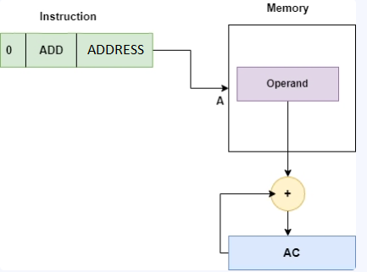
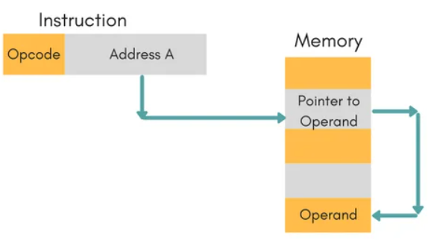
7. Direct Addressing Modes:
The effective address of the operand resides in the address field of the instruction.
The operand resides in the memory, and the address field of the instruction gives its address.
Only one reference to the memory is required to fetch the operand.
Also known as absolute addressing mode.
Example: ADD, [1000H]
1 Implied/Implicit Addressing Modes
2 Immediate Addressing Modes
3 Register Direct Addressing Modes
4 Register Indirect Addressing Modes
5 Auto-Increment Addressing Modes
6 Auto-Decrement Addressing Modes
7 Direct Addressing Modes
8. Indirect Addressing Modes
The address field of the instruction gives the address of the memory location that contains the effective address of the operand.
Two references to the memory are required to fetch the operand
This addressing mode slows down the execution as it requires multiple memory lookups to find the operand.
Example: ADD M
8 Indirect Addressing Modes
9 Displacement Addressing Modes
10 Relative Addressing Modes
11 Indexed Addressing Modes
12 Base Register Addressing Modes
13 Stack Addressing Modes

Slide 41
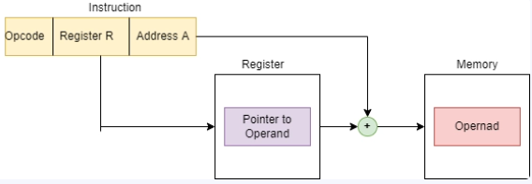
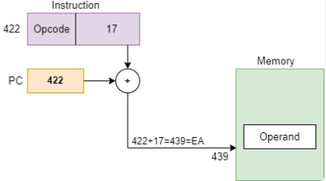
9. Displacement Addressing Modes:
The displacement is added to the instruction’s address part to obtain the effective address of the operand.
EA = A + (R) Here, the address field holds two values, A: Base value R: displacement value.
Example: MOV R1, [1000H+09H]
1 Implied/Implicit Addressing Modes
2 Immediate Addressing Modes
3 Register Direct Addressing Modes
4 Register Indirect Addressing Modes
5 Auto-Increment Addressing Modes
6 Auto-Decrement Addressing Modes
7 Direct Addressing Modes
10. Relative Addressing Modes
This mode is another version of the displacement address mode. The program counter’s content is added to the instruction’s address part to obtain the effective address.
EA = A + (PC) Here, EA: Effective address, PC: program counter.
( Often used with Branch type instructions )
Example: MOV R1, [SI+PC]
The instruction’s address is usually a signed number.
8 Indirect Addressing Modes
9 Displacement Addressing Modes
10 Relative Addressing Modes
11 Indexed Addressing Modes
12 Base Register Addressing Modes
13 Stack Addressing Modes

Slide 42
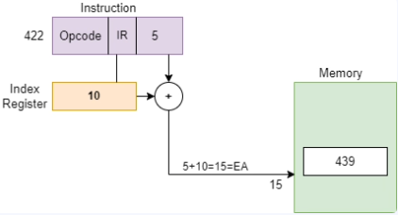
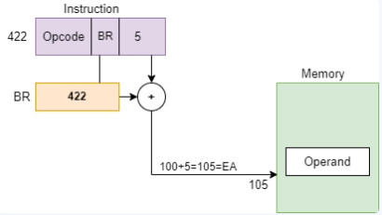
11. Indexed Addressing Modes:
The index register’s content is added to the instruction’s address to obtain the effective address.
EA = content of index register + Instruction address part
Example: MOV R1, [SI + 1000H].
1 Implied/Implicit Addressing Modes
2 Immediate Addressing Modes
3 Register Direct Addressing Modes
4 Register Indirect Addressing Modes
5 Auto-Increment Addressing Modes
6 Auto-Decrement Addressing Modes
7 Direct Addressing Modes
12. Base Register Addressing Modes
This mode is another version of the displacement address mode. To obtain the effective address, the base register’s content is added to the instruction’s address.
EA = A + (R)
  A: Instruction address,
  R: Pointer to the base address.
Example: MOV R1, [1000H+BX]
8 Indirect Addressing Modes
9 Displacement Addressing Modes
10 Relative Addressing Modes
11 Indexed Addressing Modes
12 Base Register Addressing Modes
13 Stack Addressing Modes

Slide 43
1 Implied/Implicit Addressing Modes
13. Stack Addressing Modes:
In this mode, the operand is at the top of the stack.
For example: ADD, this instruction will POP the top two items from the stack, add them, and will then PUSH the result to the top of the stack.
It helps in reducing the number of bits in the instruction's addressing field.
It facilitates pointers, indexing of data, and counters for loop controls.
2 Immediate Addressing Modes
3 Register Direct Addressing Modes
4 Register Indirect Addressing Modes
5 Auto-Increment Addressing Modes
6 Auto-Decrement Addressing Modes
7 Direct Addressing Modes
8 Indirect Addressing Modes
The difference between the two Indexed Addressing Mode and Base Register Addressing Mode is in the way they are computed. An index register is assumed to hold an index number that is relative to the address part of the instruction. A base register is assumed to hold a base address and the address field of the instruction gives displacement relative to this base address. Base register addressing mode is used in computers to facilitate the relocation of programs in memory.
9 Displacement Addressing Modes
10 Relative Addressing Modes
11 Indexed Addressing Modes
12 Base Register Addressing Modes
13 Stack Addressing Modes

Slide 44
Applications of Addressing modes
Addressing Mode | Applications
Immediate Addressing Mode | Initialize the register to a constant value.
Direct Addressing Modes Register Direct Addressing Mode | Helps access static data and implement variables.
Indirect Addressing Modes Register Indirect Addressing Mode | Helps implement pointers and pass arrays as parameters.
Relative Addressing Mode | Helps in program relocation at runtime. And in changing the sequence of instructions during execution.
Index Addressing Mode | Helps in the array and record implementation.
Base Register Addressing Mode | Helps in writing relocatable code and handling recursive procedures.
Auto-Increment Addressing Mode Auto-Decrement Addressing Mode | Helps implements loops and stacks.

Slide 45
Advantages of Addressing modes
They improve performance by efficiently utilizing the CPU cache and reducing the memory read latency.
Addressing Modes are used for implementing complex data structures in memory as they provide mechanisms such as indexing.
Program sizes can be reduced drastically as the code can be compacted which allows faster execution of instructions.
Addressing modes give you the flexibility to use different ways of specifying the address of operands in your instructions.

Slide 46
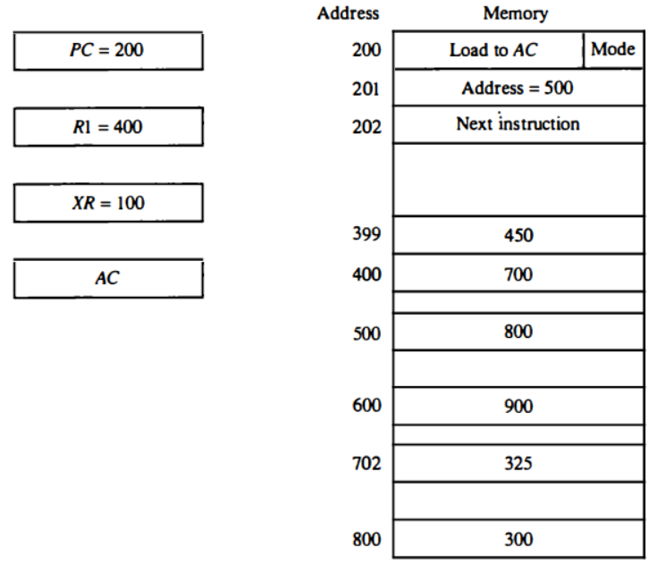
Example: Addressing modes
To show the differences between the various modes, we will show the effect of the addressing modes on the instruction defined in Fig.
The two-word instruction at addresses 200 and 201 is a "load to AC" instruction with an address field equal to 500.
The first word of the instruction specifies the operation code and mode, and the second word specifies the address part.
PC has the value 200 for fetching this instruction. The content of processor register R1 is 400, and the content of an index register XR is 100.
AC receives the operand after the instruction is executed. The figure lists a few pertinent addresses and shows the memory content at each of these addresses.

Slide 47
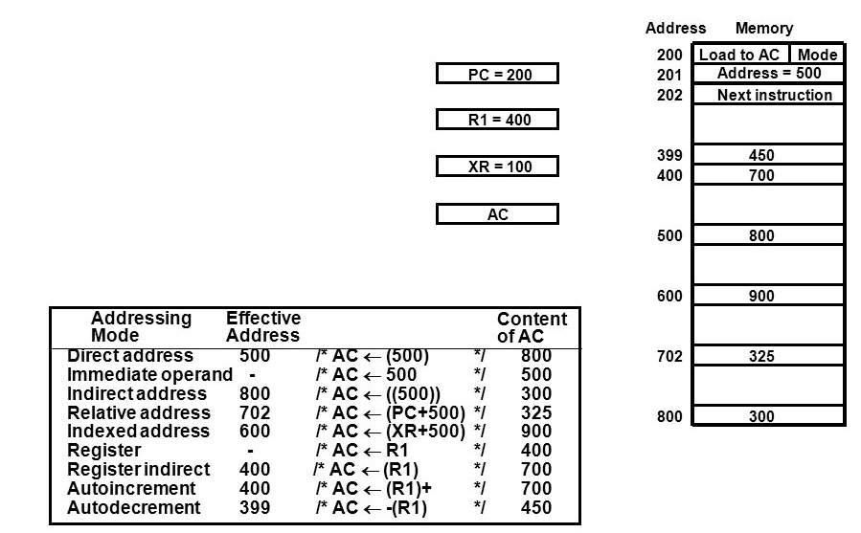
Example: Addressing modes

Slide 48
5. Data transfer and manipulation

Slide 49
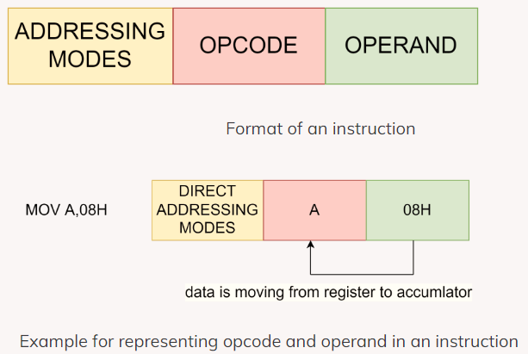
Introduction
Opcode: Operation codes are known as opcodes. The first component of an instruction, known as an opcode, instructs the computer on what task to carry out.
Operand: The second component of an instruction, known as an operand, instructs the computer where to locate or store the data or instructions.

Slide 50
Types of Instructions
There are certain basic operations included in every computer's instructions set. The computer instructions are classified into three categories:
  Data Transfer Instructions
  Data Manipulation Instructions
  Program Control Instructions

Slide 51
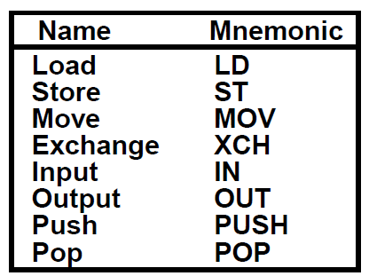
Data Transfer Instructions
Data transfer instructions move data from one location to another, without changing the binary information content. They are also called copy instructions.
Typically the transfers are between memory and processor registers, between processor registers and input and output registers, and among the processor registers themselves.

Slide 52
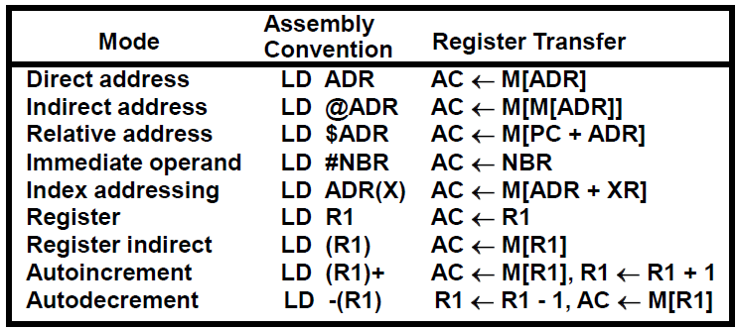
Data Transfer Instructions
With different Addressing Modes: Eight addressing modes for Load instruction

Slide 53
Data Manipulation Instructions
Data manipulation instructions are those instructions that manipulate or change the content of the data/registers/memory.
It performs operations on data and provides the computational capabilities of the Computer.
Data manipulation instructions can be categorized into three parts:
  Arithmetic instruction
  Logical and bit manipulation instructions
  Shift instructions

Slide 54
1. Arithmetic Instructions
Arithmetic instructions include increment, decrement, add, subtract, multiply, divide, add with Carry, subtract with Borrow, and negate that is (2’s) two's complement. If there’s a negative number, it is considered as negate (so two's complement).
Name | Mnemonic
Increment | INC
Decrement | DEC
Add | ADD
Subtract | SUB
Multiply | MUL
Divide | DIV
Add with carry | ADDC
Subtract with borrow | SUBB

Slide 55
2. Logical and bit manipulation instructions
Name | Mnemonic
Clear | CLR
Complement | COM
AND | AND
OR | OR
Exclusive-OR | XOR
Clear carry | CLRC
Set Carry | SETC
Complement Carry | COMC
Enable Interrupt | EI
Disable Interrupt | DI
These logical instructions consider each operand bit individually and treat it as a Boolean variable.
Basically, logical instructions help perform binary operations on strings of bits stored in registers.

Slide 56
3. Shift instructions
Shift instructions allow the bits of a memory byte or register to be shifted one-bit place to the right or the left.
There are basically two types of shift instructions — arithmetic and logical.
  Arithmetic shifts consider the contents of the memory byte or register to be a signed number. So, when the shift is made, the number is arithmetically divided by two (right shift) or multiplied by two (left shift).
  Logical shifts consider the contents of the register or memory byte to be just a bit pattern when the shift is made.
Name | Mnemonic
Logical Shift Right | SHR
Logical Shift Left | SHL
Arithmetic Shift Right | SHRA
Arithmetic Shift Left | SHLA
Rotate Right | ROR
Rotate Left | ROL
Rotate Right through carry | RORC
Rotate Left through carry | ROLC

Slide 57
6. Program Control

Slide 58
Program control Instructions
Program control instructions modify or change the flow of a program.
It is the instruction that alters the sequence of the program's execution, which means it changes the value of the program counter, due to which the execution of the program changes.
Features:
  These instructions cause a change in the sequence of the execution of the instruction.
  This change can be through a condition or sometimes unconditional.
  Flags represent the conditions.
  Flag-Control Instructions.
  Control Flow and the Jump Instructions include jumps, calls, returns, interrupts, and machine control instructions.
  Subroutine and Subroutine-Handling Instructions.
  Loop and Loop-Handling Instructions.

Slide 59
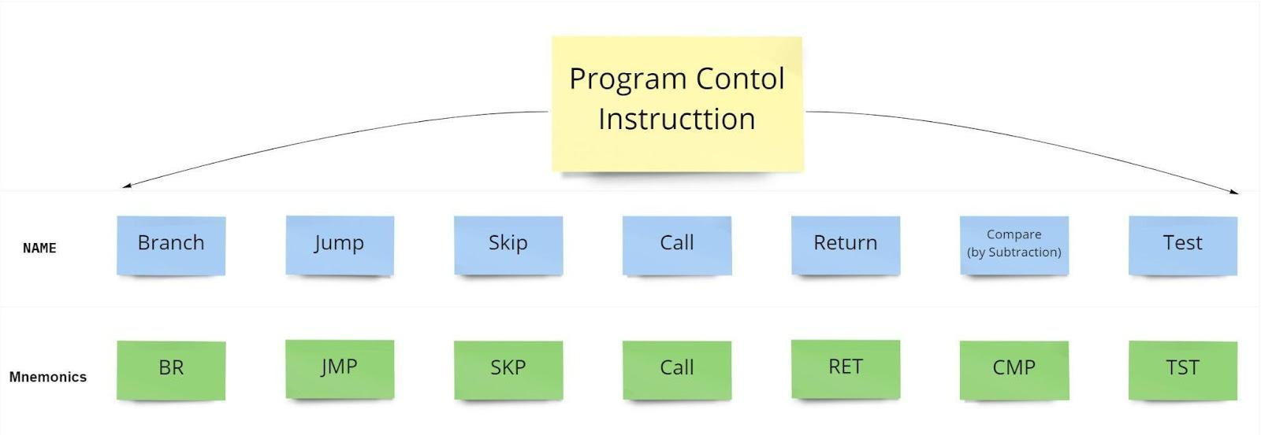
Program control Instructions

Slide 60
Program control Instructions
Program Control Instructions | Description
Branch (BR) | Branch which means it is an unconditional jump. It is unconditional branching wherever we specify the address we need to branch.
Skip (SKP) | Skip instructions is used to skip one(next) instruction. It can be conditional or unconditional. It does not need an address field. In the case of conditional skip instruction, the combination of conditional skip and an unconditional branch can be used as a replacement for the conditional branch.
Jump (JMP) | The jump instruction transfers the program sequence to the memory address given in the operand based on the specified flag.
Compare (CMP) | The Compare instruction performs a comparison via a subtraction, with difference not retained. CMP compares register sized values, with one exception.
CALL and RETURN | The CALL and RETURN instructions interrupt the flow of a program by passing control to an internal or external subroutine. An external subroutine is another program. The RETURN instruction returns control from a subroutine back to the calling program and optionally returns a value.
TEST | TEST instructions perform the AND of two operands without retaining the result, and so on.

Slide 61
Status Bit Conditions/ Flag, Processor Status Word
To check different conditions for branching instructions like CMP (compare) or TEST can be used. Certain status bit conditions are set as a result of these operations.
V | Z | S | C
Status bits mean that the value will be either 0 or 1 as it is a bit. We have four status bits:
  "V" stands for Overflow: based on certain bits, i.e., if extra bits are generated into our operation.
  "Z" stands for Zero: If the output of the ALU(Arithmetic Logic Unit) is 0, then the Z flag is set to 1, otherwise, it is set to 0.
  "S" stands for the Sign bit: If the number is positive, the Sign(S) flag is 0, and if the number is negative, the Sign flag is 1.
  "C" stands for Carry: if the output of the ALU operation generates Carry, then C is set to 1, else C is set to 0.

Slide 62
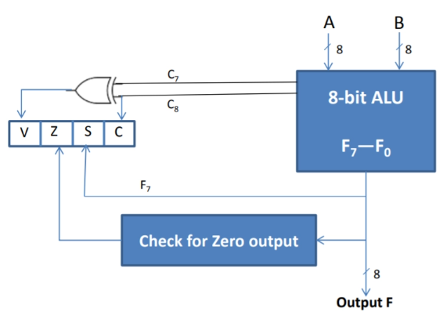
Status Bit Conditions/ Flag, Processor Status Word

Slide 63
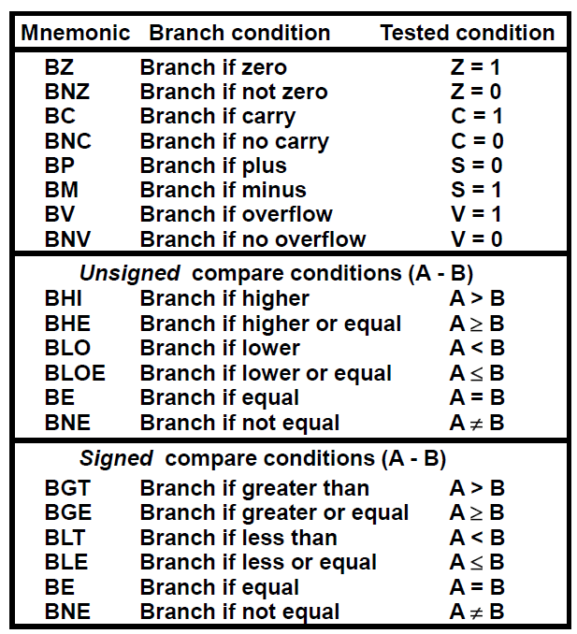
1. Conditional Branch Instructions
A conditional branch instruction is basically used to examine the values that are stored in the condition code register to examine whether the specific condition exists and to branch if it does.
Each conditional branch instruction tests for a different combination of Status bits for a condition.

Slide 64
2. SUBROUTINE CALL AND RETURN
Subroutine is a self-contained sequence of instructions that performs a given computational task.
It may be called many times at various points in the main program.
When called, branches to 1st line of the subroutine and at the end, returned to the main program.
Different names for the instruction that transfers program control to a subroutine
  Call subroutine
  Jump to subroutine
  Branch to a subroutine
  Branch and save the return address

Slide 65
2. SUBROUTINE CALL AND RETURN
Two Most Important Operations are Implied:
  Branch to the beginning of the Subroutine - Same as the Branch or Conditional Branch.
  Save the Return Address to get the address of the location in the Calling Program upon exit from the Subroutine
Locations for storing Return Address
  Fixed Location in the subroutine (Memory)
  Fixed Location in memory
  In a processor Register
  In memory stack - most efficient way

Slide 66
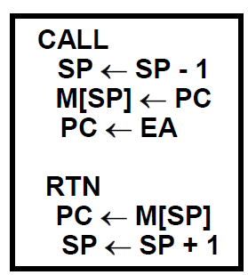
2. SUBROUTINE CALL AND RETURN
In Memory Stack

Slide 67
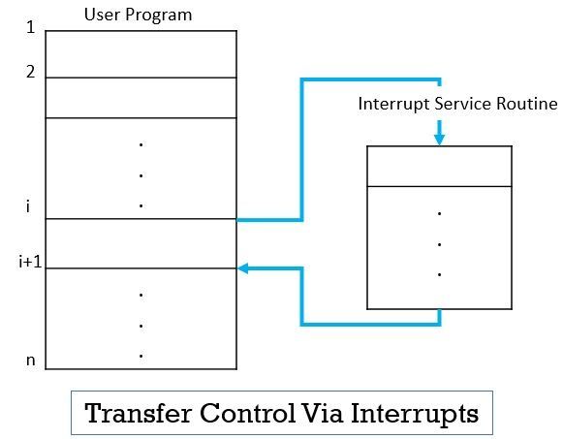
3. Program Interrupt
An interrupt is a signal emitted by a device attached to a computer or from a program within the computer.
An interrupt temporarily stops or terminates a service or a current process.
Types of Interrupts:
  External interrupts
  Internal interrupts
  Software interrupts

Slide 68
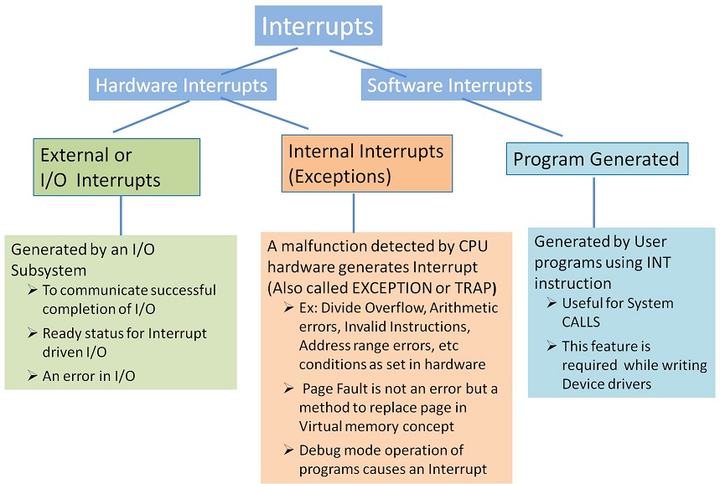
3. Program Interrupt

Slide 69
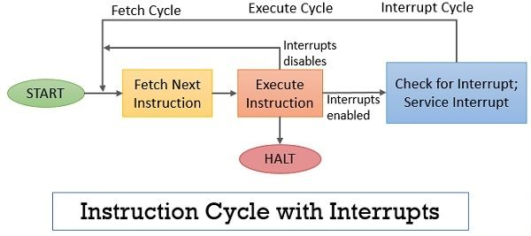
3. Interrupt Procedure
Step 1 − First device issues interrupt to CPU.
Step 2 − Then, the CPU finishes the execution of the current instruction.
Step 3 − CPU tests for pending interrupt requests. If there is one, it sends an acknowledgment to the device which removes its interrupt signal.
Step 4 − CPU saves program status word onto the control stack.
Step 5 − CPU loads the location of the interrupt handler into the PC register.
Step 6 − Save the contents of all registers from the control stack into memory.
Step 7 − Find out the cause of interrupt, or interrupt type, or invokes the appropriate routine.
Step 8 − Restore saved registers from the stack.
Step 9 − Restore the PC to dispatch the original process

Slide 70
7. RISC, and CISC

Slide 71
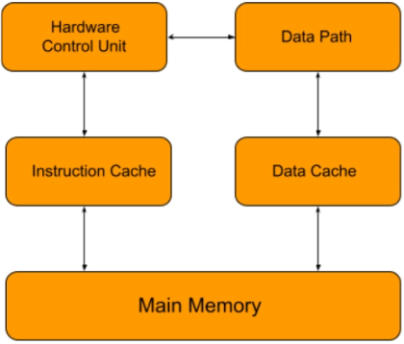
Reduced Instruction Set Computer Processor (RISC)
RISC is a microprocessor architecture that uses a simple set of instructions that can be substantially modified.
It is designed to reduce the time it takes for instructions to execute by optimizing and reducing the number of instructions. It means that each instruction cycle has only one clock per cycle, and each cycle consists of three parameters: fetch, decode, and execute.
The RISC processor can also combine multiple complex instructions into a simple one. RISC chips require several transistors, making them less expensive to develop and reducing instruction execution time.
Examples of RISC processors are PowerPC, Microchip PIC, SUN's SPARC, RISC-V.
RISC Architecture

Slide 72
Features of RISC Processor
RISC processors use one clock per cycle (CPI) to execute each instruction in a computer. Each CPI also comprises the methods for fetching, decoding, and executing computer instructions.
Multiple registers in RISC processors allow them to hold instructions, reply fast to the computer, and interact with computer memory as little as possible.
The RISC processors use the pipelining technique to execute multiple parts or stages of instructions to perform more efficiently.
RISC has a simple addressing mode and fixed instruction length for the pipeline execution.
5.) It uses LOAD and STORE instructions to access the memory location.

Slide 73
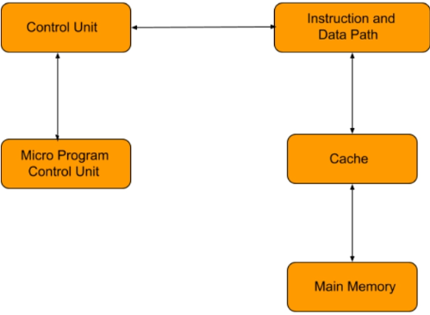
Complex Instruction Set Computer (CISC)
Intel developed the CISC processor.
It has an extensive collection of complex instructions that range from simple to very complex and specializes in the assembly language level, which takes a long time to execute the instructions.
CISC approaches reducing the number of instructions on each program and ignoring the number of cycles per instruction.
It emphasizes building complex instructions directly in the hardware because the hardware is always faster than the software.
CISC chips are relatively slower than RISC chips but use little instructions.
Examples of CISC processors are AMD, Intel x86, and the System/360.
CISC Architecture

Slide 74
Features of CISC Processor
CISC may take longer than a single clock cycle to execute the code.
The length of the code is short, so it requires minimal RAM.
It provides more accessible programming in assembly language.
It focuses on creating instructions on hardware rather than software because they are faster to develop.
5.) It comprises fewer registers and more addressing nodes, typically 5 to 20.

Slide 75
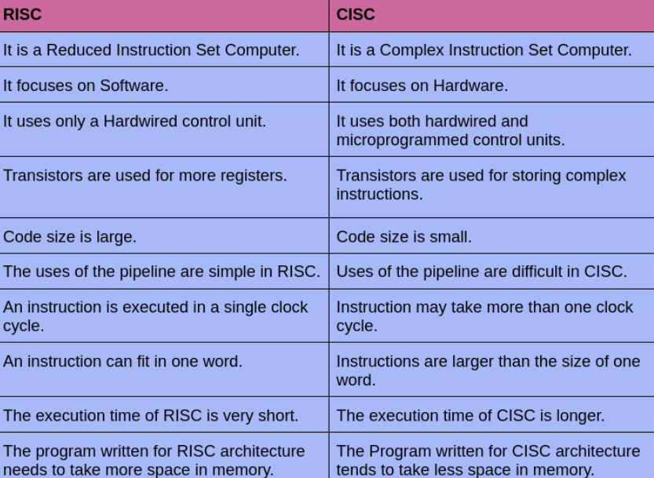
Difference Between RISC And CISC

